Slide 1
Machine Learning on Dayton Electricity Data
Ayush Raj

Slide 2
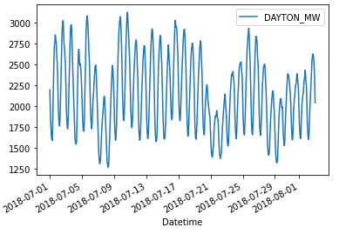
Introduction to Dataset
Got the data from Kaggle
Features: Contains hourly MW (megawatt) readings from the city of Dayton, Ohio
Length of time series
Start date: Dec 31, 2004
End date: Jan 3, 2018
Minimum MW reading: 982 MW
Maximum MW reading: 3746 MW
Machine learning task: From a specific timestamp, use the past 10 days’ MW readings to predict the MW reading 24 hours in the future
MW Readings in July 2018

Slide 3
Data Pre-processing
Overall, the data was very clean before I pre-processed it.
Did not have any missing data
So, pre-processing just involved creating X_train, X_test, y_train, and y_test
Shifted X and Y by hours_in_future (24)
Had to do this to correspond the 240 x values with the y label 24 hours ahead
Rescaled the data to work with Linear Regression and the LSTM
Batched the data for Keras
In X_train and X_test, I created 240-vectors of the past 10 days’ MW readings for each timestamp
These corresponded to the label (y_train and y_test) 24 hours in the future
Train-test split was 85% to 15%
Created X_train, X_test, y_train, and y_test for linear regression
Instead of (None, 240, ____) as the shape of X_train/X_test, I changed it to (240, ____)
Instead of (None, _____) as the shape of y_train/y_test, I changed it to (_____)

Slide 4
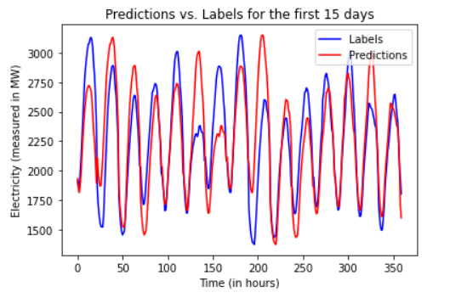
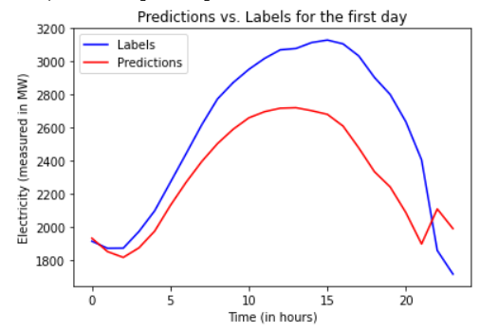
Models
I had 3 models
Baseline model: predict the last entry of each vector
Used non-rescaled data
Calculated Mean Squared Error: 47093.03
Overall, the model did not do too well, but it did not do terribly either.

Slide 5
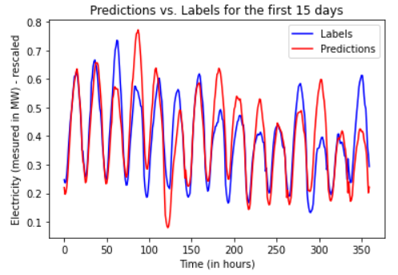
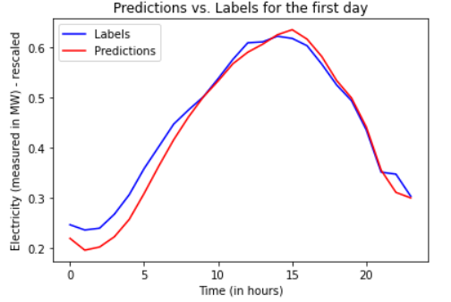
Models
I had 3 models
Linear Regression
Used scikit-learn linear regression with rescaled data
Created an array “preds” which held the predictions
Calculated MSE: 0.003
Overall, the model did pretty well. I’ll compare it with the LSTM later on.

Slide 6
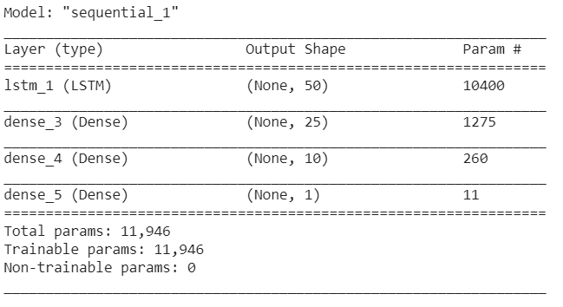
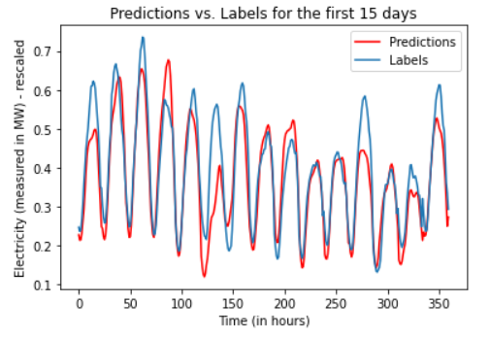
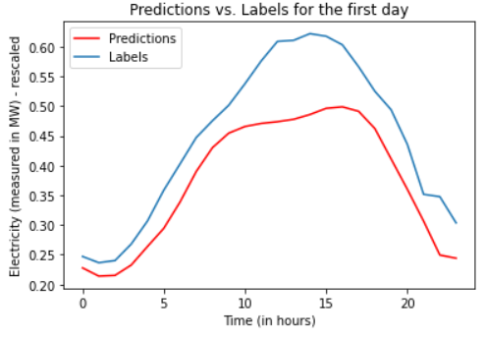
Models
I had 3 models
LSTM (Long Short-term Memory Network)
Created LSTM with rescaled data
Layers: see image on right
Adam Optimizer
Trained for 25 epochs, early_stopping ended it early because validation loss doesn’t improve
Calculated MSE: 0.002
Overall, the model did better than linear regression, but just slightly.

Slide 7
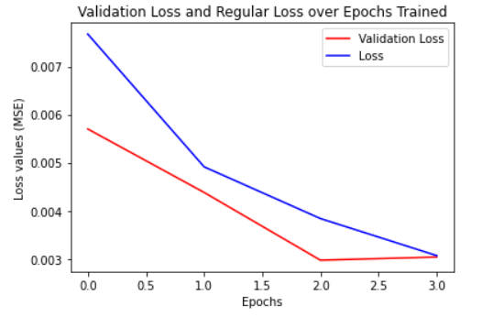
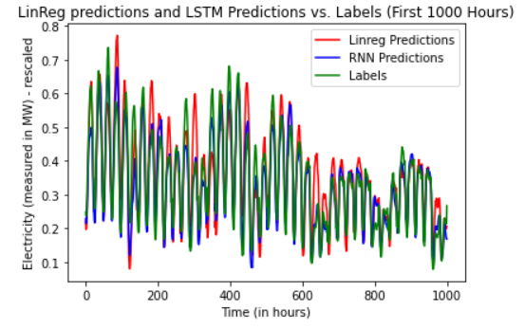
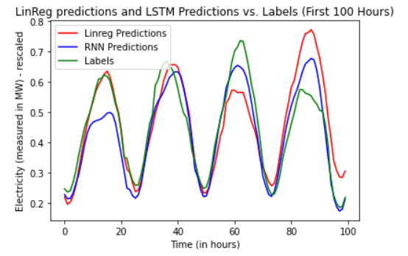
Models
I had 3 models
LSTM (Long Short-term Memory Network) - continued
Comparing the validation loss and the loss over the epochs trained:
Comparing Linear Regression with the LSTM

Slide 8
Future Improvements
Predict 72 hours in the future instead of 24
Use more than 10 days of MW values to make predictions
Make changes to the RNN
Use MAPE loss instead of MSE
Add more layers + more epochs by adding patience to the early_stopping
See if I can improve the performance
Try this model on other electricity data (from the same Kaggle link)
Examples: Northern Illinois, Virginia, Kentucky, etc.

